Slide 1

TSA Complaints
Program Success

Slide 2
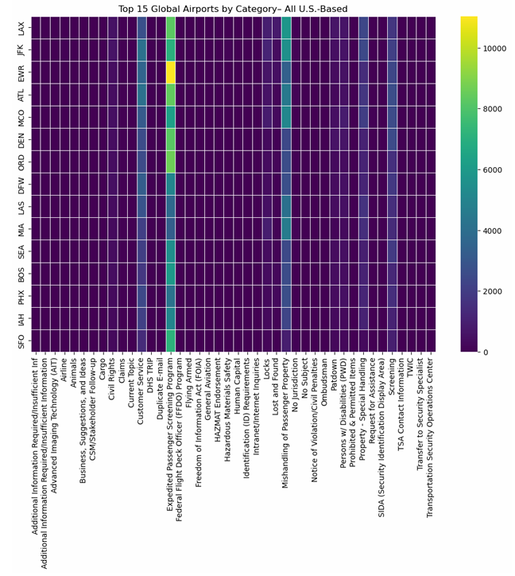
Complaints related to Expedited Passenger Screening represent one of the largest complaint categories in the dataset.

Slide 3
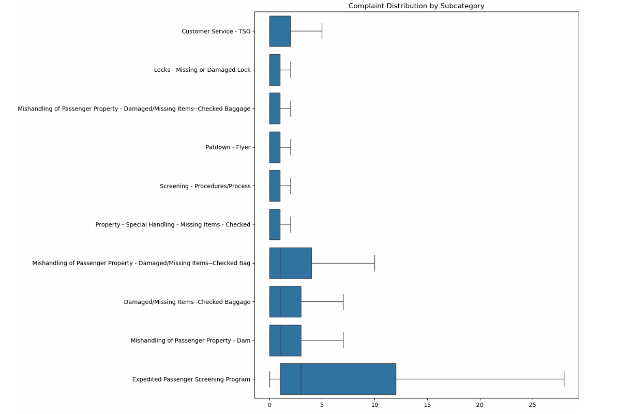
Interestingly, Expedited Passenger Screening continues to dominate even at the subcategory level, remaining the single largest generator of complaints and suggesting that the subcategory classifications may lack sufficient differentiation.

Slide 4
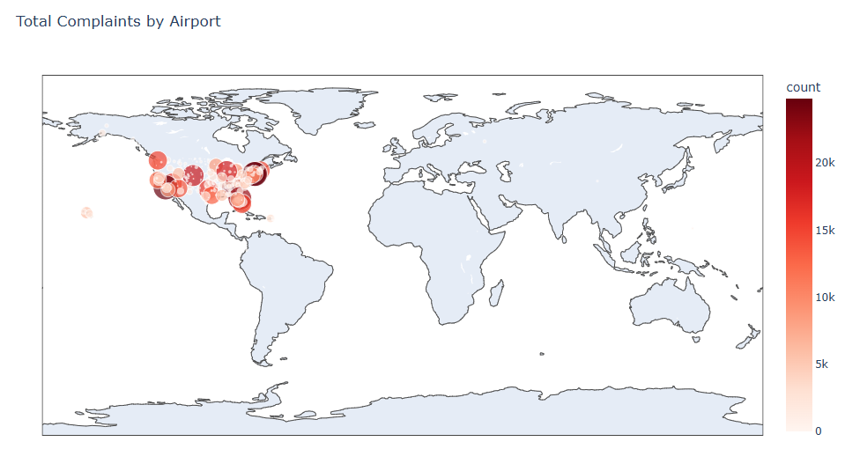
United States Dominates Complaints Worldwide

Slide 5
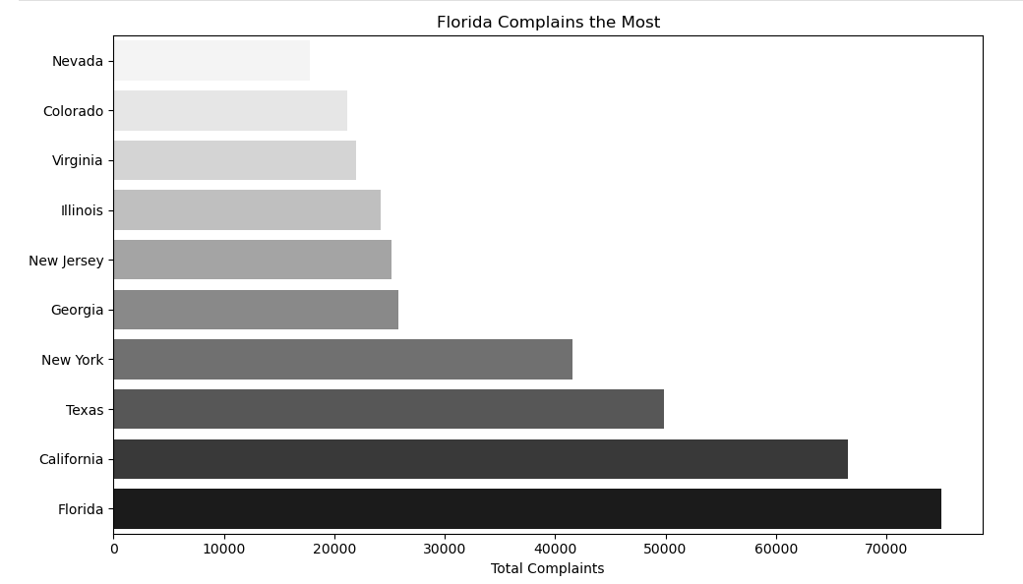

Slide 6
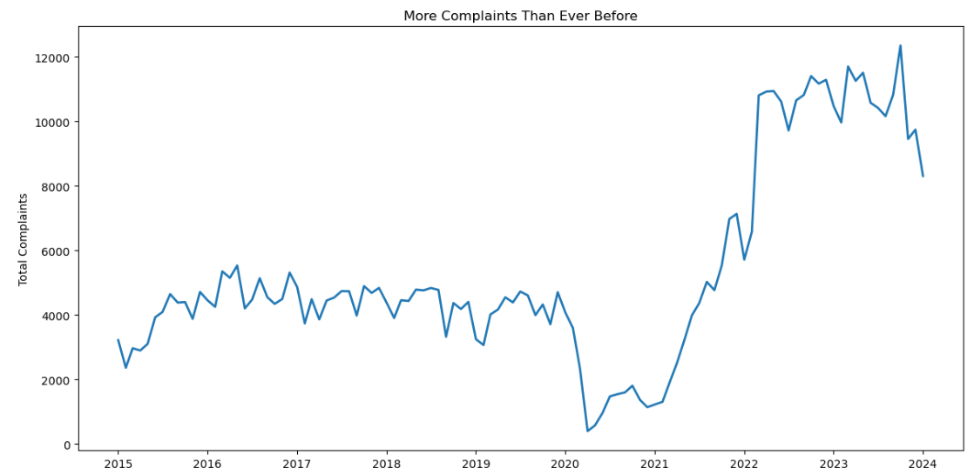

Slide 7

More Complaints Equals More Feedback Opportunities
Higher complaint volumes provide a larger pool of customer feedback to analyze and interpret.
Increased complaints can reveal recurring operational weaknesses that may otherwise go unnoticed.
A greater volume of feedback allows for more reliable trend identification and pattern detection.
Complaints offer direct insight into customer experience gaps and service friction points.
When leveraged effectively, higher complaint frequency can serve as a catalyst for targeted process improvement and policy refinement.

Slide 8
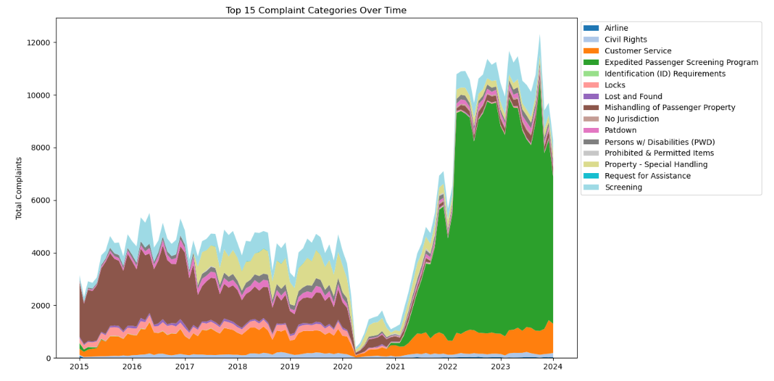

Slide 9
Major Shift in Complaints
The expedited customer screening program is resulting in more complaints than ever before
The program needs to be revamped, and feedback incorporated into the program upon its relaunch
Mishandling of customer property has improved greatly since 2015

Slide 10

Call to Action
Establish a cross-functional review committee to systematically evaluate complaint data and identify recurring themes.
Conduct structured root-cause analysis to determine the underlying drivers of high-volume complaint categories.
Prioritize an in-depth assessment of the Expedited Passenger Screening program as the primary focus area.
Develop targeted process improvements and monitoring mechanisms to reduce recurring screening-related complaints.

